Slide 1
Web Design Fundamentals /
Basic Web Design
Cascading Style Sheets (CSS), DIV, SPAN – ITEWEBDES / ITWD113

Slide 2
CASCADING STYLE SHEETS (CSS)
A style language that lets you control the display characteristics of your Web site.
Notes:
HTML 3.2
HTML 4.0
CSS solved a big problem, html is never intended to contain formatting html is intended to define the content
Formatting every single page become a tiring process

Slide 3
<font> VS CSS
<font> style element was introduced by browser developers to help Web designers bypass the design limitations of HTML but tailored only towards one type of display medium, the computer screen.
A style sheet can display information for different devices.

Slide 4
What are they?
A set of style rules that tell the web browser how to present a web page or document.
Styles are normally stored in style-sheets
External style sheets are stored in .css files
Multiple style sheets will cascade into one
Notes:
In earlier versions of HTML, style characteristics, such as fonts, backgrounds, and other aspects of the look of the webpage were controlled from within the page itself.
The evolution of cascading style sheets allowed for the rules of formatting and presentation to be done in a different manner than before.

Slide 5
Reasons for Using CSS
Build from the ground up to replace traditional Web design methods
Faster download times
Shorter development time
Greater control over the typography in a Web page
Notes:
TEN
1. The World Wide Web Consortium (W3C) created CSS to replace HTML tables, font tags, frames, and other presentational hacks of HTML elements. 2. Reduction of file size is about 50% less than a Web page built with traditional Web design methods. 3. Easily tweak the design of a thousand-page site with just a few edits of one CSS file. 4. CSS's ability to control typography better than a wimpy FONT tag is a wonderful gift. No longer do we need to use the font tag or single-pixel GIFs (SPG) to create leading, change font colors, font families, and much more.

Slide 6
Reasons for Using CSS
It's easy to write
Improvements in accessibility
Print designs as well as Web page designs
Better control over the placement of elements in Web page
Notes:
5. It's easy to write. You can create and edit CSS as easily as you can hand code HTML. 6. Improvements in accessibility. Using CSS effectively means structuring content with HTML. With structured HTML -- using <p> tags only for paragraphs, heading tags only for headlines, tables for only tabular data, and so on -- you increase your audience size without building separate versions of your site. 7. Print designs as well as Web page designs. Create presentations not only for Web browsers, but also for other media like print or PowerPoint-like presentations. 8. Better control over the placement of elements in Web page. Table control vs div

Slide 7
Reasons for Using CSS
The design of Web pages is separated from the content
Better search engine rankings
Notes:
9. The design of Web pages is separated from the content. By keeping the design in separate files linked to the HTML pages, you reduce the likelihood of your page designs falling apart over time as different contributors add to the Web page. 10. Better search engine rankings. With only HTML used for structuring content in a Web document instead of rigging tags for design, search engines will spider your Web page effectively, and more likely give you a higher page ranking.

Slide 8
Evolution of CSS
CSS Version | Description
CSS 1 | The first version released in December 1997
CSS 2 | Released in May 1998
CSS 2.1 | All major browser supports CSS, released in 2005
CSS level 3 (CSS3) | Work started in 1998. This is the latest release of CSS
Note that in some cases minimal difference in browser view will be noticed.

Slide 9
What are they?
CONTENT
STYLE
Web page
Notes:
Essentially, what we are doing when we use cascading style sheets is separating the content of the page from the style or formatting of the page. This has advantages, in that once the style sheet is loaded locally, all other pages that are based on that style sheet will load quicker. The reason being that the stylistic markup for defining the appearance of the page is loaded separately from the content of the page.

Slide 10
What are they?
CONTENT
STYLE
Web page
Notes:
Essentially, what we are doing when we use cascading style sheets is separating the content of the page from the style or formatting of the page. This has advantages, in that once the style sheet is loaded locally, all other pages that are based on that style sheet will load quicker. The reason being that the stylistic markup for defining the appearance of the page is loaded separately from the content of the page.

Slide 11
What are they?
CSS
Notes:
One cascading style sheet can be used to set the style and format for many different web pages. The biggest advantage is that if the web author wants to make whole changes to a website, the style editing takes place in one location (the CSS), yet is applied to all related locations (the pages). Imagine a large site with hundreds of pages. To change even on item on each page, without a CSS, would require editing of each of the hundreds of pages. In contract, a CSS based website would require the editing of only one file – the CSS.

Slide 12
What are they?
CSS
CSS
CSS
Physical layout
Text
CSS
CSS
Headings
Body
Notes:
Likewise, a single webpage can be formatted by several different cascading style sheets. These sheets can be external to the page, or embedded in it. They may address some or all of the same elements, or they may address different aspects of the same elements. For instance, one CSS may be designed for only addressing the physical layout of the page, while another handles the formatting of page headers. Still another may address the formatting of body elements, and a fourth could address the formatting of text elements.

Slide 13

Devices
BROWSER
Content
CSS
CSS
CSS
MOBILE
Content
PRINT

Slide 14
Types of CSS
Inline style
Internal style sheet
External style sheet and Imported
Notes:
There are four basic types of cascading style sheets: external, internal, imported and inline.

Slide 15
Inline Style
Least flexible
Requires each element to be tagged if you want them to appear differently
Looses the advantage of using CSS
<h1 ALIGN="center" STYLE="background: #000080; font: 36pt/40pt courier; font-variant: small-caps; border: thick dashed blue">
Welcome to my home page!
</h1>

Slide 16
Internal / Embedded style sheet
Style characteristics are embedded in the HEAD section of the webpage
Perhaps best used when a single page requires a unique style sheet
<head>
<style>
hr {color:sienna;}
p {margin-left:20px;}
body {background-image:url("images/back40.gif");}
</style>
</head>

Slide 17
External style sheet
Connection made via the LINK tag
Use the optional TYPE attribute to specify a media type
type/css
Index.htm
<head>
<link rel="stylesheet" type="text/css" href="mystyle.css">
</head>
Filename.CSS
hr {color:sienna; }
p {margin-left:20px; }
body {background-image:url("images/back40.gif");
}

Slide 18
Imported
Allows for using style sheets from other sources
Must be included at the beginning of the style sheet using the @import statement
Other CSS rules can be included
<style type="text/css">
@import url("import3.css"); p { color : #f00; }
</style>
Notes:
The @import rule allows you to include external style sheets in your document. It is a way of creating a style sheet within your document, and then importing additional rules into the document.
<style type="text/css"> @import url("import1.css"); @import url "import2.css"; </style>
Add delays

Slide 19
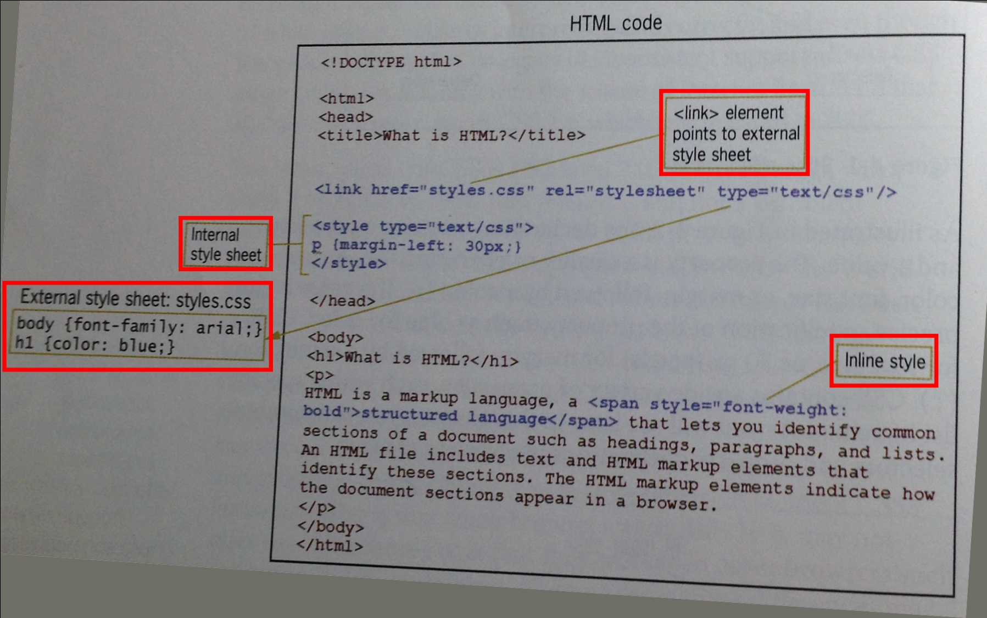
Methods of Combining CSS with HTML

Slide 20
Inserting a CSS
Inline
<p style=“color: yellow; font-family: verdana”>
This is a paragraph
</p>
Notes:
The most restrictive, and perhaps the “heaviest” method of stylistic markup is the inline CSS. In this case, each element on the page would need to have it’s own formatting information included inside the tag (in this case the paragraph tag) in order to achieve the desired formatting. The inline style somewhat defeats the concept of using cascading style sheets.

Slide 21
Inserting a CSS
Internal/embedded sheet
<head>
<style type=“text/css”>
hr { color: navy;}
body {margin-left: 20px;}
</style>
</head>
Notes:
In this example, the style information is embedded into the HEAD element of the webpage. While this is not as “light” as the external CSS, it is much better than the inline version. In this case, all of the formatting for the page is in one location, rather than having each individual element/tag on the page having to have its own stylistic information attached to it.

Slide 22
Inserting a CSS
External sheet
<head>
<link rel=“stylesheet” type=“text/css” href=“mystyle.css” />
</head>
Notes:
The syntax for linking the webpage to an external CSS. In this case, the page will draw its formatting information from the style sheet “mystyle.css”, located at the same level as the page itself.

Slide 23
Cascading multiple sheets
You can use multiple sheets to define the style of your document
Internal styles will override external styles, if they are duplicated
Notes:
As mentioned earlier, multiple sheets can be used to describe the formatting of a page. However, if there is a mixture of internal and external style sheets, the internal sheet will take precedence in any situation where similar elements are described differently.

Slide 24
Cascading multiple sheets
h3 {color: red; text-align: right; font-size: 8pt} (external CSS)
h3 {text-align: center; font-size: 20pt} (internal CSS)
will yield
h3 {color: red; text-align: center; font-size: 20pt }
Notes:
For example, the external CSS has described the h3 (heading 3) tag one way, while the internal style sheet has described it differently. Notice that the descriptions of the h3 tag are slightly different. The color property is not included in the internal CSS. What would this combination of styles yield? How will an h3 heading look on this particular page?

Slide 25
Sheet weight or Precedence
Inline style
Internal Style
External style
Browser’s style sheet
Greatest weight
Least weight

Slide 26
Understanding the Cascade
Cascading
Determining rule weight by specificity
Rules with more specific selectors take precedence over rules with less specific selectors
Determining rule weight by order
Based on order of rule within style sheet
Those listed later take precedence over those listed earlier in the style sheet

Slide 27
Understanding the Cascade
Inheritance
Based on hierarchical structure of documents
CSS rules inherit from parent elements to child elements:
Thus <LI> elements will inherit style rules from <UL> elements unless a style rule is specifically set for the <LI> element

Slide 28
Basic CSS Syntax
Notes:
Let’s take the time to look at some basic cascading style sheet syntax. Style sheets can be created in both Macromedia’s Dreamweaver and Microsoft’s Front Page, or they can be created in something as simple as a basic text editor such as Notepad. It is important to remember that the file is just a text file, and that it must have the .css extension when it is saved.

Slide 29
Basic CSS Syntax
Three parts:
selector
property
value
selector {property: value}
declaration
Notes:
A basic CSS markup contains three essential parts: the selector, the property of that selector and the value for the property. Notice that the property and the value are enclosed in curly braces, and that the property and value are separated by a colon.

Slide 30
Basic CSS Syntax
selector {property: value}
selector: the basic HTML element tag you wish to define
body
property: the attribute of the selector that you wish to change
body {color
value: the particular markup value for that attribute
body {color : black}
Notes:
The selector is the basic element tag that we wish to define. In this case, we will bedefining some aspect of the formatting of the <body> tag.

Slide 31
Properties with multiple words
If the value has multiple words, put the value in quotes
p {font-family: “sans serif” }
Notes:
In some situations with some values for a property, we may have a value that has more than one word. In these cases, we enclose the value in quotes. In this example, we are defining the value of the font family property. Sans serif being two words would require it to be enclosed in quotes.

Slide 32
Multiple properties
You can specify multiple properties to a single selector. Properties must be separated by a semicolon.
P { text-align: left; color: red }
Notes:
Cascading style sheets also allow us the opportunity to define multiple properties within a single selector. In this example, we are defining the text alignment and color properties in the same paragraph <p> selector. When we have multiple properties in the same selector, they must be separated by a semicolon.

Slide 33
Basic CSS Syntax
To make properties more readable, put each on a separate line.
p { text-align: center;
color: navy;
font-family: arial
}
Notes:
As we develop our style sheets, we may find that it is easier to put each property of a selector on a separate line.

Slide 34
Grouping
Selectors can be grouped so that a common property can be specified
h1,h2,h3,h4,h5,h6
{ color: red}
<h1> This is a level 1 heading </h1>
<h2> This is a level 2 heading </h2>
Notes:
We can also assign the same property attributes to several different selectors in the same statement. In this example, all of the heading levels (1-6) have been assigned the same color. Even though they may be different fonts and font sizes, or have different alignment properties, they will all be displayed in yellow.

Slide 35
Descendants
Selectors can be descendants
P B { color: yellow }
In this example, only those <B> elements within a <P> element would be yellow
<p><b> This would be yellow </b></p>
<p> This would not be yellow </p>
Notes:
We can also assign the same property attributes to several different selectors in the same statement. In this example, all of the heading levels (1-6) have been assigned the same color. Even though they may be different fonts and font sizes, or have different alignment properties, they will all be displayed in yellow.

Slide 36
CSS Syntax - class
The class selector allows you to create different styles for the same HTML element.
p.right { text-align: right; }
p.center { text-align: center; }
Notes:
Within our selectors, we can also create a class. A class permits us to define different styles for the same selector element. In our example, we have defined 2 separate classes for the paragraph <p> element. Our first class is for paragraph text that we want right aligned, and the second is for text that we want to have center aligned. Notice that the class is designated by the selector, a period and the word class, before entering the property and value in the curly braces.

Slide 37
CSS Syntax - class
p.right { text-align: right }
<p class=“right”>
This paragraph will be right aligned.
</p>
Note: the class name must be in quotes inside the opening tag
Notes:
Here’s how it works in the page. Our CSS had defined the class p.right { text-align: right }. In the markup of the page, we have assigned the class to this paragraph element <p class=“right”> so that the text that is contained with this paragraph element will be right aligned. Take note of the syntax: the word class is followed by the equal sign and then the class name in quotes. The closing tag </p> is required.

Slide 38
CSS Syntax - class
This is an improper use of the class selector:
<p class=“right” class=“center”>
This paragraph will be right aligned.
</p>
Only one class selector can be included inside the tag
Notes:
This illustrates the improper use of the class selector. An element cannot have more than one class selector assigned to it. In this example, the second, and any subsequent class selectors, would be ignored. The text would align right.

Slide 39
CSS Syntax - class
<p class=“center bold”>
This is a paragraph.
</p>
Note: the paragraph will be styled by the class “center” AND the class “bold”
Notes:
Here’s how it works in the page. Our CSS had defined the class p.right { text-align: right }. In the markup of the page, we have assigned the class to this paragraph element <p class=“right”> so that the text that is contained with this paragraph element will be right aligned. Take note of the syntax: the word class is followed by the equal sign and then the class name in quotes. The closing tag </p> is required.

Slide 40
CSS Syntax - class
You can also create a class selector free of a tag name if you want all tags that have that class to be formatted the same.
.center { text-align: center }
Any tag with a “center” class will be aligned center
Notes:
As a shorthand, you can omit the element name for a class selector if you want all elements that contain the same class selector to format the same. In this example, we have created a class called center, to which we have assigned one property (align center).

Slide 41
CSS Syntax - class
.center { text-align: center }
<h1 class=“center”>
This heading will be centered
</h1>
<p class=“center”>
So will this text
</p>
Notes:
Here we can see that the <h1> element and the <p> element, although different, will both align center since they both contain the “center” class selector.

Slide 42
CSS Syntax - id
While the class selector can apply to several different elements, the id selector can only apply to one, unique element.
p#para1 { text-align: center;
color: green }
Apply style to p element with id=“para1”
Notes:
The id selector is similar to the class selector, with one very large exception – it can only apply to one, unique element. In this example, we have created an id selector named para1. This is a selector for the <p> element, and defines the alignment and color properties for any text that would have this id.

Slide 43
CSS Syntax - id
p#para1 { text-align: center;
color: green }
<p id=“para1”>
This text would be centered and green
</p>
Notes:
Here we see the results. There can be only one para1 id selector in our web document. The style properties, as we can see from the description of the id selector at the top, would apply to this text and this text only.

Slide 44
CSS Syntax - comment
You can insert comments to help you describe the particular style
Comments open with /* and are closed with */
/* This is a comment */
P { color: red;
/* This is another comment */
Font-family: verdana }
Notes:
In developing good cascading style sheets, it may be advisable to include comments to describe what the particular selector is being used for in the layout or format of the page. Comments can be inserted anywhere into the sheet, so long as they are bracketed by the /* */. This tells the browser that these are comments only and can be ignored in the formatting of the page.

Slide 45
Background Properties
Notes:
Let’s take a look at how we can apply some of these properties to various aspects of your web page. We will begin by looking at the background of your web document.

Slide 46
Background properties
Define the background effects of an element
Effects include color, using an image for a background, repeating an image and positioning an image
Notes:
By setting the background properties, we can specify the color of the background; what, if any, image we want to use on the background; whether or not we want to have the image repeat; or if we want the image to appear in a specific position.

Slide 47
Background properties
Basic syntax
background
background-color
background-image
background-repeat
background-attachment
background-position
Notes:
Here we can see the basic syntax for setting background elements. The background element by itself allows us to specify all of the background elements in one statement. Each of the other elements is self-explanatory.

Slide 48
Background properties
All attributes can be set in a single declaration:
background: #000000 url(asd.gif) no-repeat fixed center
Notes:
When setting all of the attributes in a single declaration, we would follow this format: color, image, repeating, attachment and position. We can leave an attribute out with no ill effect. For instance, if we wanted to set our background to a solid color, there would be no need for the image attribute. We would simply leave it out of the declaration. Likewise, if we had a repeating background image, we may have no need for a color attribute.

Slide 49
Background properties
Setting the body background (internal CSS)
body { background: #000000 url(asd.gif) no-repeat fixed center }
Notes:
Here we can see how the background for the <body> element would be specified in an internal style sheet.

Slide 50
Background properties
Setting the body background (external CSS)
body: { background: #000000 url(asd.gif) no-repeat fixed center }
Notes:
The same <body> element background specified in an external style sheet.

Slide 51
Background properties
Elements can also be set separately
body
{ background-image: url(asd.gif);
background-color: navy }
Notes:
If we want to only specify certain attributes of the background for a particular element, we can do so as well.

Slide 52
Text Properties
Notes:
Next, let’s take a look at the properties of text elements.

Slide 53
Text properties
Controls the appearance of text in the web page
Notes:
The text properties control how our text will look in the page. This is not to be confused with fonts, as they are 2 separate things.

Slide 54
Text properties
Commonly used attributes
color
direction
text-align
text-decoration
text-indent
Notes:
Some comonly used text properties include color, direction, alignment, decoration and first line indentation. Let’s look at some of these in detail.

Slide 55
Text properties
color
sets the color of the text
color can be represented by the color name (red), an rgb value (rgb(255,0,0)), or by a hexadecimal number (#ff0000)
Syntax
body {color: #ff0000}
Notes:
The color property allows us to set the color of the text. The color value can be set as a color name (red, navy, white), an rgb (red/green/blue) value (255,0,0 – red) or by a hexidecimal value (#ff0000).

Slide 56
Text properties
direction
sets the direction of the text
can be set as left to right (ltr) or right to left (rtl)
Syntax
body {direction: rtl}
Notes:
The direction property allows us to specify the direction of the text, either from left to right or right to left.

Slide 57
Text properties
text-align
aligns the text in an element
possible values are left, right, center and justify
Syntax
p {text-align: center}
Notes:
The text-align property allows us to set the alignment of the text, either as left, center, right or justified.

Slide 58
Text properties
text-decoration
adds certain decoration elements to the text
possible values are none, underline, overline, line-through and blink
Syntax
p {text-decoration: underline}
Notes:
Text decoration can add underlines, lines over the text, lines through the text or have the text blink. Note: blinking text is not recommended, as it may lead persons with certain conditions to have seizures.

Slide 59
Text properties
text-indent
indents the first line of text inside an element
possible values are length (defines a fixed value) and % (defines a % of the parent element)
Syntax
p {text-indent: 20px}
Notes:
Similar to setting the first line indentation in a word processing document, the text-indent property allows us to set the length of indentation of the first line of text. We can specify a fixed length, or a percentage of the width of the parent element. In our example, the <p> element would define the width if we were using the percentage value.

Slide 60
Font Properties
Notes:
While text properties primarily deal with the layout of the text on the page, font properties deal with the actual appearance of the type faces.

Slide 61
Font properties
Define the look of the font in text areas
One of the broader sets of properties in CSS
Notes:
Font properties define the look of the font when it is in a text area. This is one of the broader sets of properties in CSS since we can manipulate fonts in a much broader manner.

Slide 62
Font properties
font
font-style
font-variant
font-weight
font-size/line-height
font-family
Notes:
Some of the primary font properties are: style, variant, weight, size, and the family of fonts. Let’s explore.

Slide 63
Font properties
font-style
normal
italic
oblique
Syntax: body {font-style: italic}
Notes:
The font style property allows for italicization of text, or the more slanted oblique text.

Slide 64
Font properties
font-variant
normal
font displays as is
small-caps
font displays in all capitals, with lower case letters in smaller size
Syntax: body {font-variant: small-caps}
Notes:
The font variant allows us to use small capitals. The font will display in all capitals, however any lower case text (before the variant has been applied) will appear in a smaller size.

Slide 65
Font properties
font-weight
normal
bold
bolder
lighter
weighted values
Syntax: body {font-weight: bold}
Notes:
Font weight refers to the amount of boldness that the font will appear to have. Fonts may have the values of normal, bold, bolder and lighter, or they may be assigned a specific weight.

Slide 66
Weighted values
range from 100 – 900
400 is the same as normal weight
700 is the same as bold weight
Notes:
Font weights range from 100 to 900. A font weight of 400 is equivalent to a normal representation of the font, while a weight of 700 is equivalent to a bold font weight. Values must be in increments of 100, and cannot fall outside the range given here.

Slide 67
Font properties
font-size
xx-small to xx-large
smaller
smaller than parent
larger
larger than parent
%
% of the parent
Syntax: body {font-size: 20px}
{font-size: x-large}
{font-size: 125%}
Notes:
Font sizes can range from xx-small to xx-large, In addition, there is a smaller value and a larger value. In each of these cases, the size is relevant to the size of the font set by the parent element. The percentage value allows us to specify the size of the font as a percentage of the relevant parent elements font size. For example, if a parent element set the font size at 20 points, a font size of 125% would be 25 points.

Slide 68
Font properties
font-family
family-name
“times”, “arial”, “courier”, “verdana”
generic-family
“serif”, “sans-serif”, “monospace”
Syntax: body {font-family: verdana, sans-serif}
Notes:
When designating a value for the font family property, we can choose between a named font family or a generic family. Some common font families are times, courier, aril and verdana. Some common generic families include serif, sans serif and monospace. When listing more than one font family, you need to separate the font families with commas. It is also a good practice to include a generic font family, incase the end users browser does not have the font that you have designated. The generic family should be offered as the last option. Two word font names must be enclosed in quotes to be read correctly, such as “lucinda casual”.

Slide 69
Border Properties

Slide 70
Border properties
Allows you to specify the style, color and width of an element’s border
Many different properties can be applied

Slide 71
Border properties
You can specify the width, style, color, thickness and on which sides the border appears

Slide 72
Margin Properties
Notes:
We can specify margins around any element, not just images. Let’s look.

Slide 73
Margin properties
Define the space around elements
You can use negative values to overlap content
Margins can be set independently or collectively
Can be set to auto, a fixed length or a % of the total height of the document
Notes:
By setting margin properties, we can define the space around an element. The margin properties also give us the opportunity to have certain elements overlap by using negative values. We can set margins independently, or we can specify margins in one single declaration. Another option to have the browser set the margins automatically, have the margins of fixed length, or to have them be a percentage of the total height or width (or both) of the document.

Slide 74
Margin properties
Properties
margin
margin-top
margin-right
margin-bottom
margin-left
Notes:
The single margin property allows us to set all of the margins in one declaration. Otherwise, we can set the margins independently by using the appropriate property.

Slide 75
Margin properties
margin-bottom
auto
set by the browser
length
fixed
%
Syntax: h1 {margin-bottom: 20px}
Notes:
For example, we can set the bottom margin of our <h1> heading by using this syntax: h1 {margin-bottom: 20px In this case, the margin below any text that is tagged as a level 1 heading <h1> will be 20 pixels.

Slide 76
Margin properties
Can be set in one declaration
Think clock face
top, right, bottom, left
h1 {margin: 10px 20px 30px 40px}
Notes:
When setting the margins in one declaration, we need to remember a clock face – 12, 3, 6, 9. This corresponds to top, right, bottom, left. In our example, we have set each of the four margins to different value for this particular <h1> element.

Slide 77
Margin properties
All margins can be set the same
h1 {margin: 40px}
Notes:
If we ant all margins (top, right, bottom and left) to be set to the same value, we can use this simplified syntax: h1 { margin: 40px} where all of the margins would be set to a width of 40 pixels.

Slide 78
Margin properties
Margin settings can be paired (left and right, top and bottom)
h1 {margin: 40px 5%}
In this example, the top and bottom margins would be 40 pixels,
While the left and right margins would be 5% of the total height of
the document.
Notes:
CSS also allows us to pair the margin settings. In our example, the top and bottom margins are paired, and the left and right margins are paired. You can see that the top and bottom margins are set at 40 pixels, while the left and right margins are set a 5% of the total width of the document.

Slide 79
Margin properties
0 size margins do not need to be specified. 0px, 0pt and 0 are all equivalent.
h1 {margin: 40px 0 5% 0}
In this example, the top margin would be 40 pixels, the left and
right margins would be 0, and the bottom margin would
be 5% of the total height of the document.
Notes:
Zero means 0. In this example, we can see that the top and bottom margins are set to different values, but the left and right margins are set to 0. It doesn’t matter if the value is 0px, 0pt or 0, 0 is still 0.

Slide 80
Using the <div> and <span> Elements

Slide 81
Using the <div> and <span> Elements
The <div> (division) and <span> (span of words) elements are designed to be used with CSS.

Slide 82
Division Tag <div>
A <div> tag is a container that divides the HTML document into sections. It is used for grouping HTML elements.

Slide 83
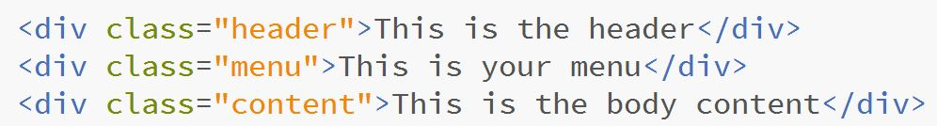
DIV TAG FOR LAYOUT
The CSS float property – float property tells elements how to arrange <div>, float values are left and right
Webpage
OUTPUT

Slide 84
Float Property
Left- The element floats to the left
Right - The element floats to the right
Inherit - Inherits this property from its parent element.
Ex:
span { color: blue; } .extra span { color: inherit; }

Slide 85
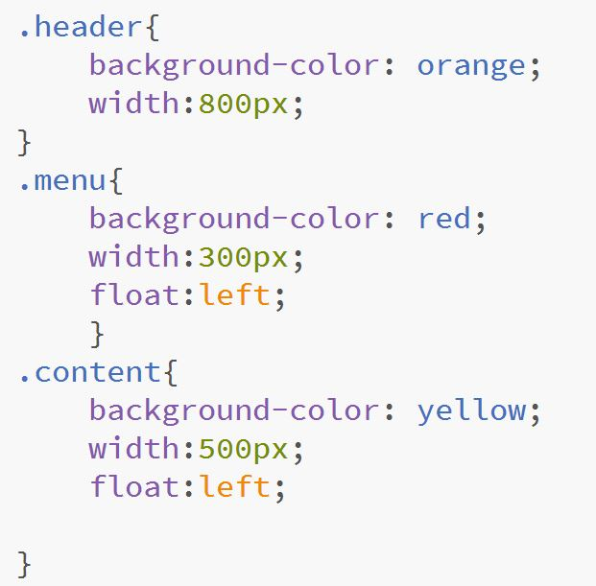
DIV TAG FOR LAYOUT
CSS using Float

Slide 86
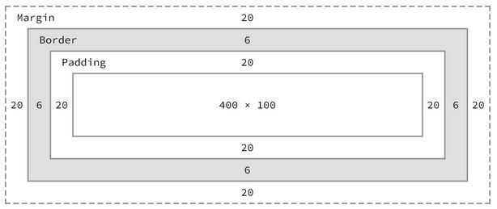
CSS BOX MODEL using <div>
Essentially a box that wraps around HTML elements that consists of: margin, borders, padding, and actual content

Slide 87
CSS syntax - <div>
<DIV> can be used with the CLASS attribute to create customized block-level elements
Declare it in the style rule:
DIV.introduction {font-size: 14pt; margin: 24 pt;}
Apply the style rule in the document:
<DIV CLASS=“introduction””>This is the introduction to the document</DIV>

Slide 88
Sample <div>
External css
#van{
width: 200px;
height: auto;
padding: 15px;
border: thin solid;
}
Html file
<html>
<head> <title> DIV </title>
<link rel="stylesheet" type="text/css" href="style.css" />
</head>
<div id=“van">
Sample text
</div>
</html>

Slide 89
Span of Words Tag <span>
A <span> elements lets you specify inline elements within a document that have their own name and style properties that reside within a line of text.

Slide 90
CSS syntax - <span>
<SPAN> can be used with the CLASS attribute to create customized inline elements
Declare it in the style rule:
SPAN.logo {color: white; background-color: black;}
Apply the style rule in the document:
<P>Welcome to the <SPAN CLASS=“logo””> Wonder Software</SPAN>Web site</P>

Slide 91
Sample <span>
External css
#logo {
color:white;
background-color: black;
}
Html file
<html>
<head> <title> SPAN </title>
<link rel="stylesheet" type="text/css" href="style.css" />
</head>
<h1>This is my sample text for <span id="logo"> span.</span></h1>
</html>

Slide 92
Using Other CSS Selectors
Besides class and id, attribute selectors can also be used such as PSEUDO-CLASS AND PSEUDO-ELEMENT SELECTORS, and CSS3 selectors.

Slide 93
Using Attribute Selectors
Example:
<p title=“flower”> This is our sample text </p>
ELEMENT HAS THREE ATTRIBUTES: title
IN CSS:
p[title] {background-color: blue;font-family: sans-serif;}

Slide 94
Using Pseudo-Class and Pseudo Element Selectors
Pseudo-class and pseudo-element selector let you express style declarations for characteristics of a document that are not signified with the standard HTML elements.
EXAMPLE:
Assume you want to change the color of a new or visited hypertext link. No HTML element directly lets you express these characteristic of the <a> element.

Slide 95
Using Pseudo-Class
The link pseudo-classes let you change the style characteristics for different hypertext link states.
Application:
a:link {color:red;}
a:visited {color: green;}
Note: Always place your link pseudo-class in the following order Link, Visited, Hover, Active
Pseudo-Class | Description
:link | Selects any unvisited link that user has not clicked
:visited | Selects any link that your user has already visited
:hover | Selects any link that your user is pointing to with the mouse pointer
:active | Selects a link for the brief moment that your user is actually clicking the link

Slide 96
Using the :hover Pseudo-Class
Lets you apply a style that appears when the user points to an element with a pointing device.
Example:
a:hover {background-color: yellow;}

Slide 97
Using the :first-letter Pseudo-Element
Apply style rules to the first letter of any element.
Example:
p:first-letter {
font-weight: bold;
font-size: 200%;
}

Slide 98
End of Module

